Slide 1

Rabin-Karp VS Knuth-Morris-Pratt
Ethan Rock - 24962399
Notes:
Jack Edmonds in 1961

Slide 2
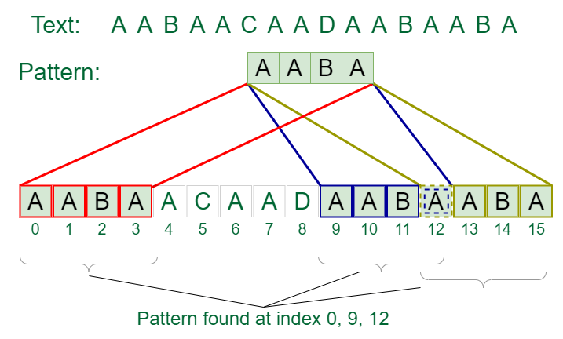
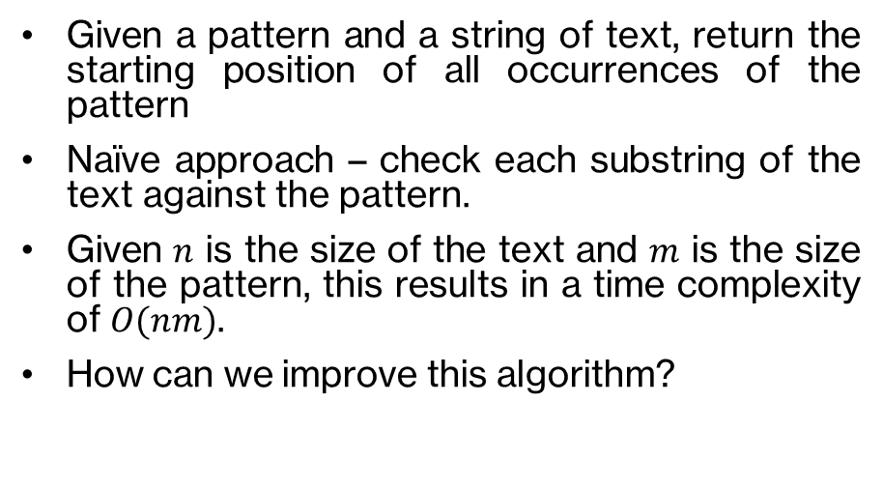
The problem – string matching
Given a pattern and a string of text, return the starting position of all occurrences of the pattern
Naïve approach – check each substring of the text against the pattern.
Given $n$ is the size of the text and $m$ is the size of the pattern, this results in a time complexity of $O(nm)$.
How can we improve this algorithm?

Slide 3
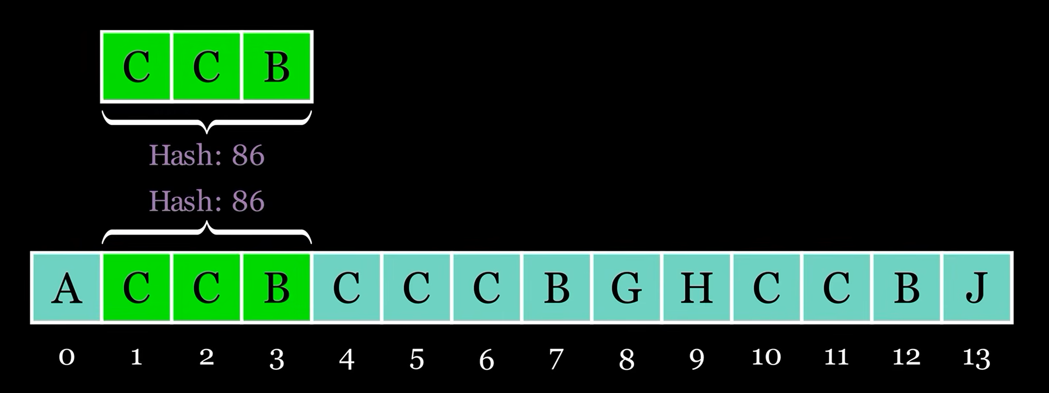
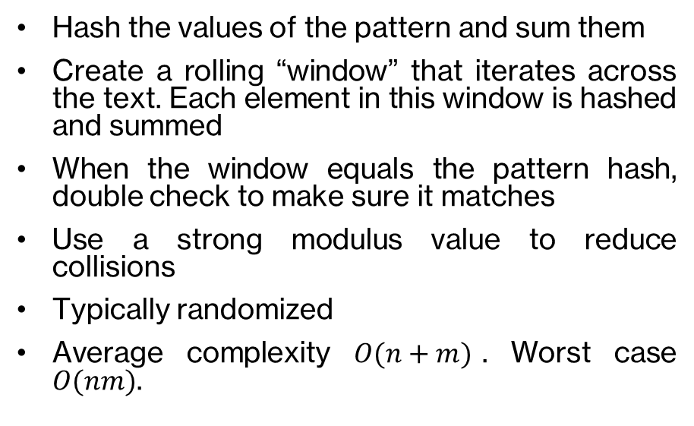
First solution – Rabin-Karp
Hash the values of the pattern and sum them
Create a rolling “window” that iterates across the text. Each element in this window is hashed and summed
When the window equals the pattern hash, double check to make sure it matches
Use a strong modulus value to reduce collisions
Typically randomized
Average complexity $O(n+m)$. Worst case $O(nm)$.

Slide 4
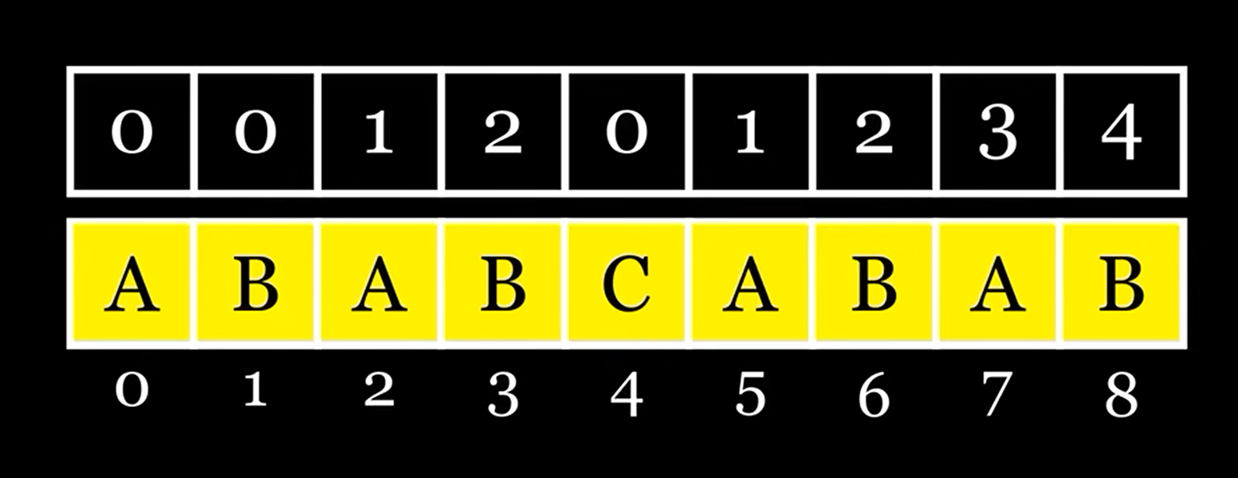
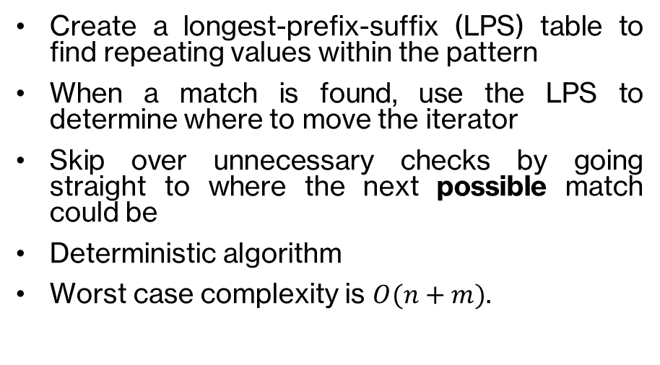
Second solution – Knuth-Morris-Pratt
Create a longest-prefix-suffix (LPS) table to find repeating values within the pattern
When a match is found, use the LPS to determine where to move the iterator
Skip over unnecessary checks by going straight to where the next possible match could be
Deterministic algorithm
Worst case complexity is $O(n+m)$.

Slide 5
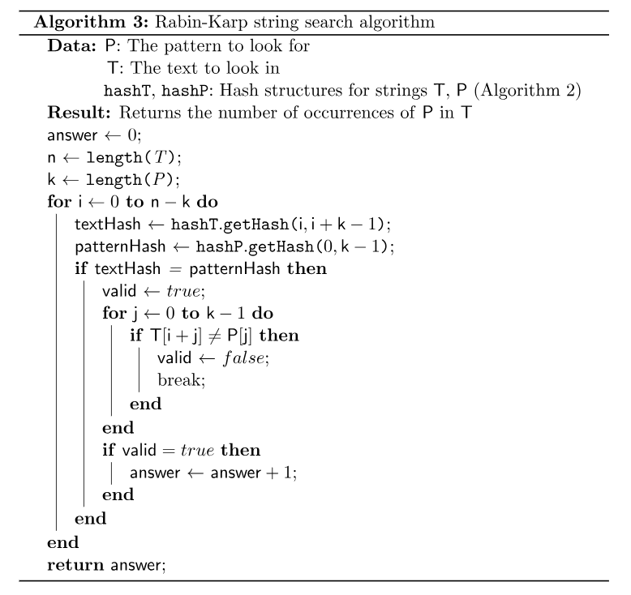
Rabin-Karp Implementation
Five key steps
  Calculate the highest power for the polynomial hash function
  Hash the pattern and the opening window by casting to unsigned char and multiplying by a base value
  Iterate over the text. Remove the first character and add the next.
  When the pattern and window are equal, double check if it matches
  Add any matches to the return vector

Slide 6
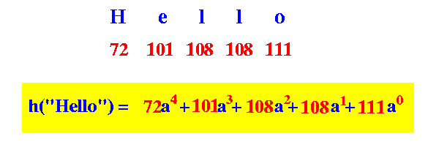
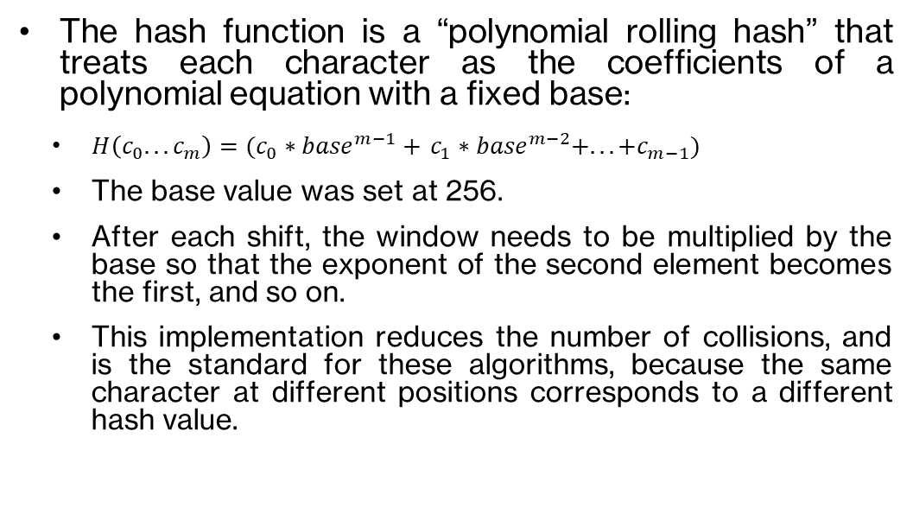
Trickiest Concept – Polynomial Hash
The hash function is a “polynomial rolling hash” that treats each character as the coefficients of a polynomial equation with a fixed base:
  $H\left(c_{0}. . . c_{m}\right)=(c_{0}∗{base}^{m−1}+$ $c_{1}∗{base}^{m−2}+. . . +c_{m−1})$
  The base value was set at 256.
  After each shift, the window needs to be multiplied by the base so that the exponent of the second element becomes the first, and so on.
  This implementation reduces the number of collisions, and is the standard for these algorithms, because the same character at different positions corresponds to a different hash value.

Slide 7

Avoiding Breaks – Double Check the Match
Even utilising a hash function, there are sometimes false positives where the window equals the pattern, without actually having matching elements.
The larger the modulus, the more possible hash values and the less collisions.
Prime numbers are also key, as they have less factors.
Nonetheless, collisions make up most of the Rabin-Karp algorithms inefficiency.

Slide 8
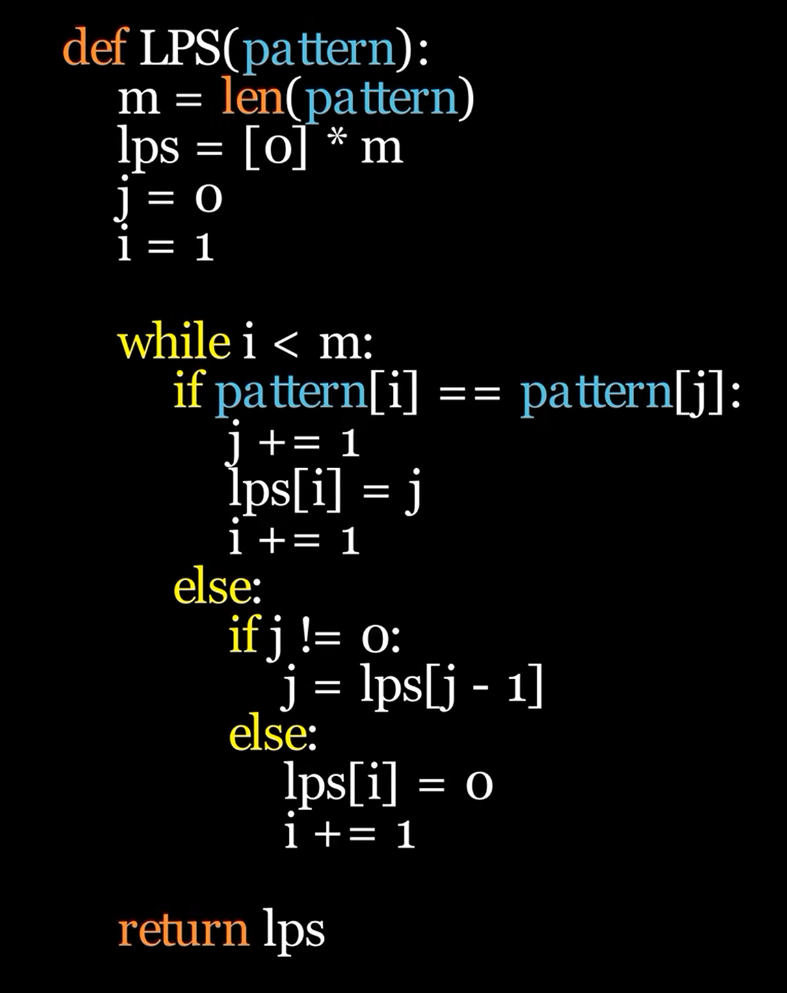
Knuth-Morris-Pratt Implementation
The main outline:
  Create the LPS table to start
  Make a pointer for both the LPS and text
  Iterate over the text
Loop logic
  If the LPS pointer is at 0 and the next character doesn’t match, only increment the text pointer
  If the next character matches. Increment both
  If the LPS pointer is not 0 and the next character doesn’t match, reduce the LPS pointer by the corresponding value in the table
  If a match is found, store it, and do the same as the previous step

Slide 9
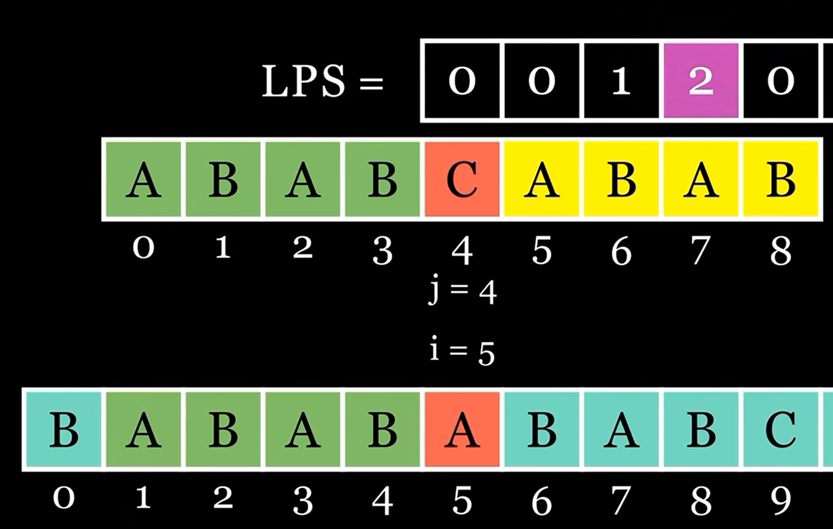
Key concept – keep part of the match
The text pointer never moves backward.
The LPS pointer doesn’t reset to the beginning, so the algorithm doesn’t need to recheck those first elements.
Works best when the pattern itself has repeating patterns or “prefix-suffixes”.

Slide 10

Making sure not to miss overlaps
It’s wrong to assume that after a match is found, that the next match must come after the last character
Overlaps like pattern “AAA” in “AAAAA” should return (0, 1, 2)
That’s why the pointer moves backwards even when a match is found

Slide 11

Testing process
Put the two algorithms head-to-head, and also investigate their weaknesses:
  Completely random test
  Large inputs for patterns and text
  Variable alphabet size test
  Periodic pattern test
  Weak modulus test
  Realistic data test

Slide 12
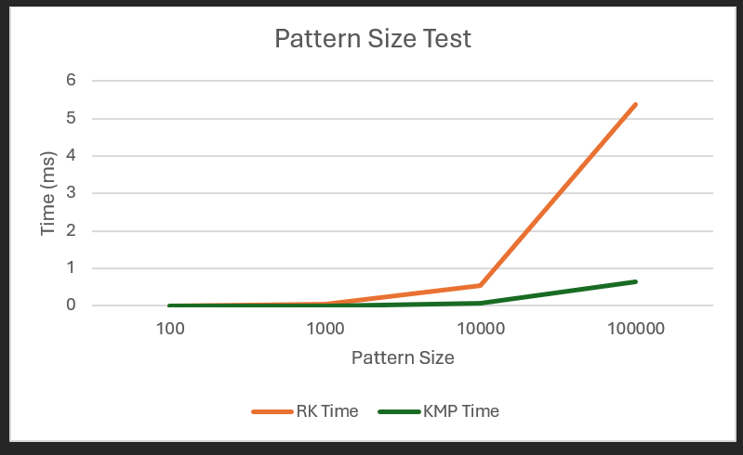
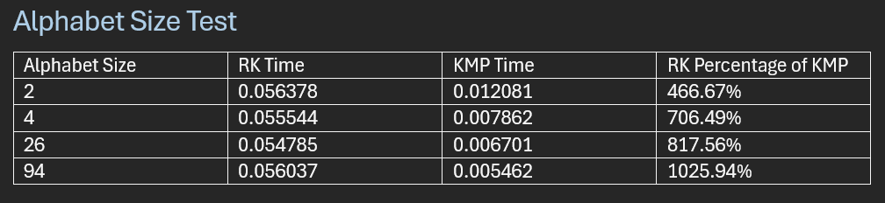
Unexpected results – Rabin-Karp floundering
RK severely outclassed in all tests, on average running 6x slower
On large inputs, the gap widens even farther
The RK algorithm performs worse with larger alphabets? Something is seriously wrong.

Slide 13
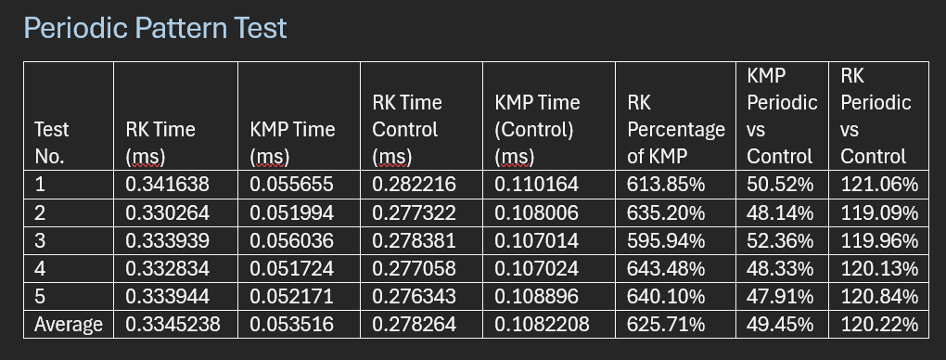
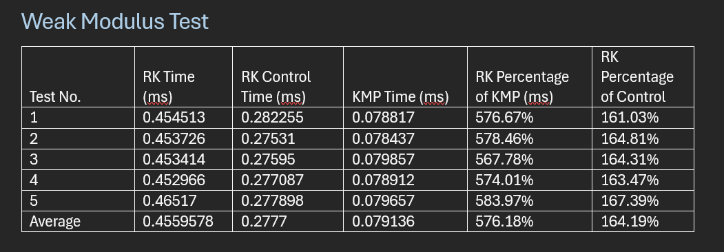
Good news – strengths highlights
The KMP algorithm performs much better with periodic patterns as expected
The RK algorithm performs much worse when the modulus is too low

Slide 14

Why the skewed results? Theory vs Implementation
The gap between the two was unexpectedly large. They are supposed to have the same time complexity on average
The answer lies in compilation, the modulus value wasn’t known before runtime, so the compiler can’t optimise it
This results in very expensive division operations that tank performance

Slide 15

The next step – redeeming Rabin-Karp?
The next step for this project would be to fix the implementation of Rabin-Karp and close that gap back to expected values
RK shows more promise with multi-pattern searching, as it can check multiple hash values simultaneously as it parses over the text

Slide 16
References
ByteQuest. (2024, January 16). Rabin-Karp algorithm visually explained [Video]. YouTube. https://www.youtube.com/watch?v=yFHV7weZ_as
ByteQuest. (2024, January 21). Knuth-morris-pratt algorithm visually explained. YouTube. https://www.youtube.com/watch?v=ynv7bbcSLKE
Wikipedia Contributors. (2023, April 8). Rabin–Karp algorithm. Wikipedia; Wikimedia Foundation. https://en.wikipedia.org/wiki/Rabin%E2%80%93Karp_algorithm
Wikipedia Contributors. (2019, October 27). Knuth–Morris–Pratt algorithm. Wikipedia; Wikimedia Foundation. https://en.wikipedia.org/wiki/Knuth%E2%80%93Morris%E2%80%93Pratt_algorithm

